Slide 2
The average person throughout their lifetime spends five years waiting in lines and queues where roughly six months of that is waiting at traffic lights.
https://www.thefactsite.com/how-much-time-people-spend-doing-stuff/#:~:text=The%20average%20person%20throughout%20their,is%20waiting%20at%20traffic%20lights.

Slide 3
How long does it take lights to change?
Signal timing cycle lengths usually fall between 45 and 120 seconds. The timing for each signal is determined based on traffic volume and traffic patterns in each particular area.
https://www.nyc.gov/html/dot/html/infrastructure/signals.shtml#:~:text=How%20long%20does%20it%20take,patterns%20in%20each%20particular%20area.

Slide 4
According to a study conducted by the European satellite navigation company TomTom, the average person spends 20 minutes each day waiting at red lights. Over the course of a lifetime, this adds up to a total of 180 days or six months spent waiting for traffic signals to change.
https://maltadaily.mt/the-average-person-waits-spends-six-months-of-lifetime-waiting-for-traffic-signals-to-change/#:~:text=According%20to%20a%20study%20conducted,for%20traffic%20signals%20to%20change.

Slide 5
Glasgow councillor says pedestrian crossing waiting time ‘should only be 30 seconds’
https://www.glasgowworld.com/news/glasgow-councillor-says-pedestrian-crossing-waiting-time-should-only-be-30-seconds-4092852

Slide 6
Road traffic injuries
pedestrians
https://www.who.int/news-room/fact-sheets/detail/road-traffic-injuries

Slide 7
Averaged over the period 2016 to 2021: an average of 8 pedestrians died and 115 were seriously injured (adjusted) per week in reported road collisions. a majority of pedestrian fatalities (56%) do not occur at or within 20m of a junction compared to 46% of all seriously injured (adjusted) casualties
https://www.gov.uk/government/statistics/reported-road-casualties-great-britain-pedestrian-factsheet-2021/reported-road-casualties-great-britain-pedestrian-factsheet-2021#:~:text=Averaged%20over%20the%20period%202016,all%20seriously%20injured%20(adjusted)%20casualties
https://www.gov.uk/government/statistics/reported-road-casualties-great-britain-pedestrian-factsheet-2021/reported-road-casualties-great-britain-pedestrian-factsheet-2021

Slide 8
People don’t wait, they just walk if the street is empty.
No matter if it was safe or not

Slide 9
State machine
Red / green?
Safe/ not safe

Slide 10
https://www.youtube.com/watch?v=DP62ogEZgkI
1 sec/ 10 miles/h (16km/h) to stop

Slide 11
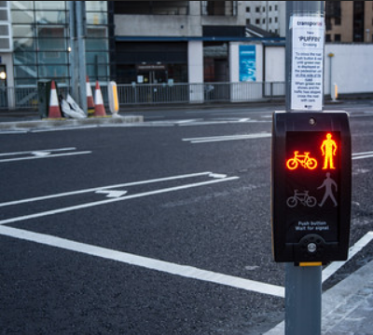
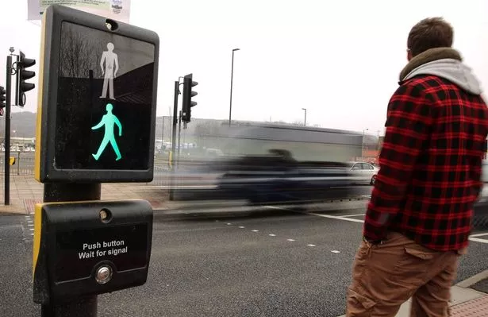

Slide 12
Realtime response
Manage the traffic light
Reduce wait time
Respond immidietly
Warn pedestrians when in danger

Slide 13
HW
Pasp pi
Camera
LEDS
Buzzer
Distance sensor (cars / bikes in the streer) or using camera?
Speed sensor (to turn off)?

Slide 14
SW
Github
Github Management tool
CI?
DC?
Unit tests?
CV?
Deep learning?
Layers?
Design document?

